Slide 1
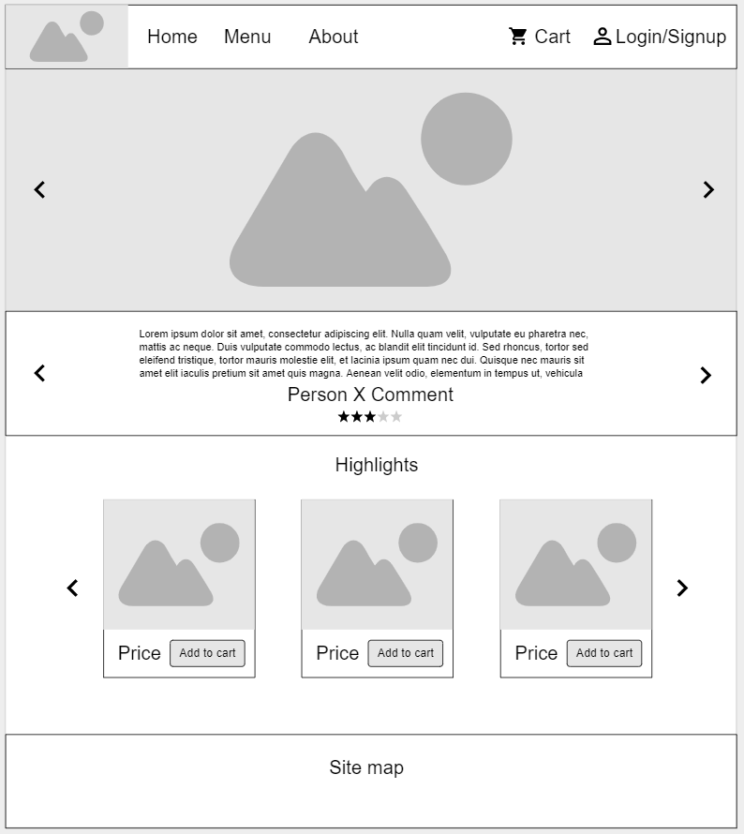
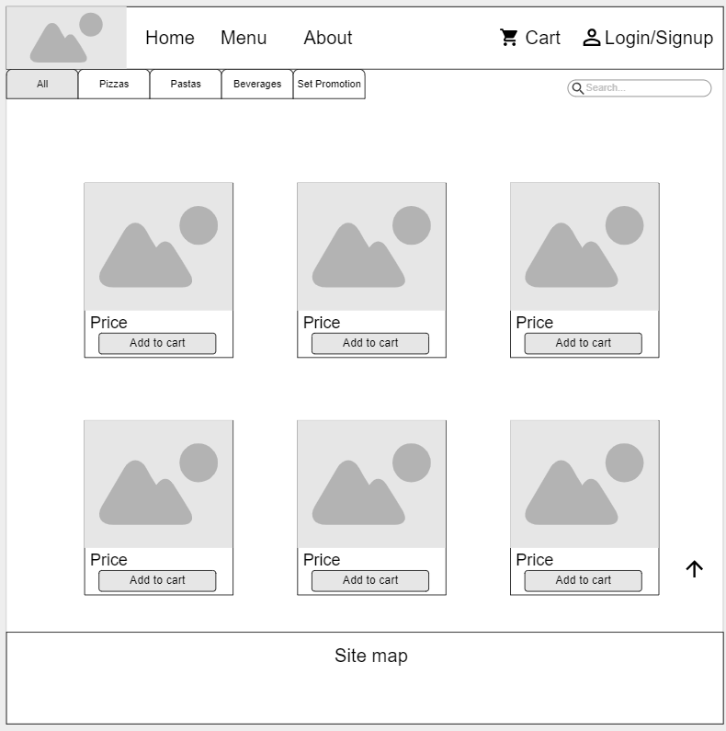
Upon clicking menu, it leads the user to the menu site
Home page
Menu

Slide 2
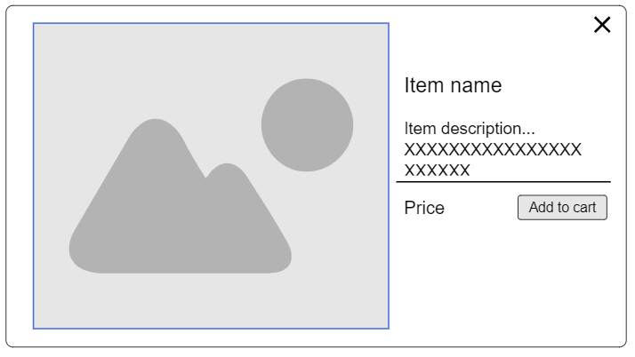
Menu
Upon clicking any item , it leads the user to the item description
Item Description

Slide 3
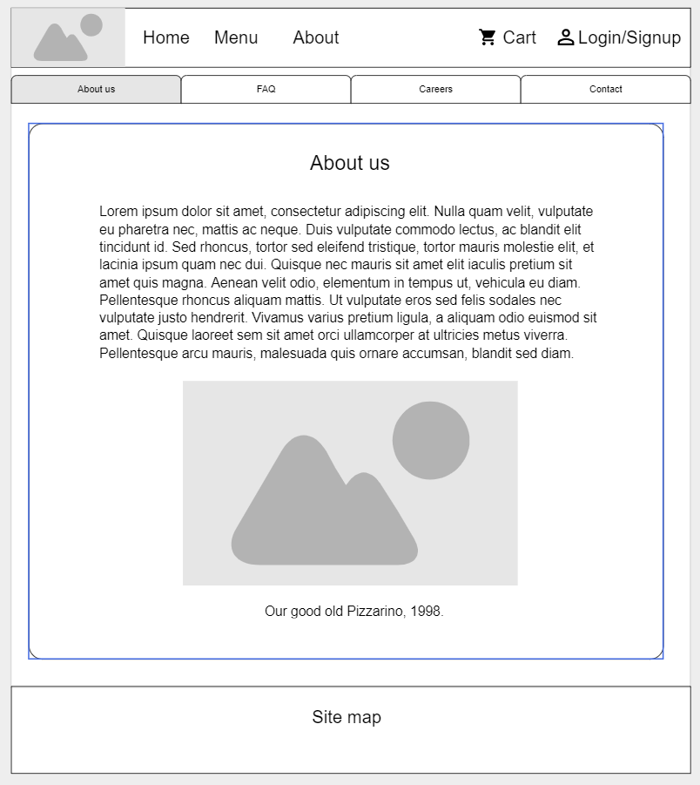
Upon clicking “about” tab on menu, it leads the user to the “about us” page
Menu
About

Slide 4
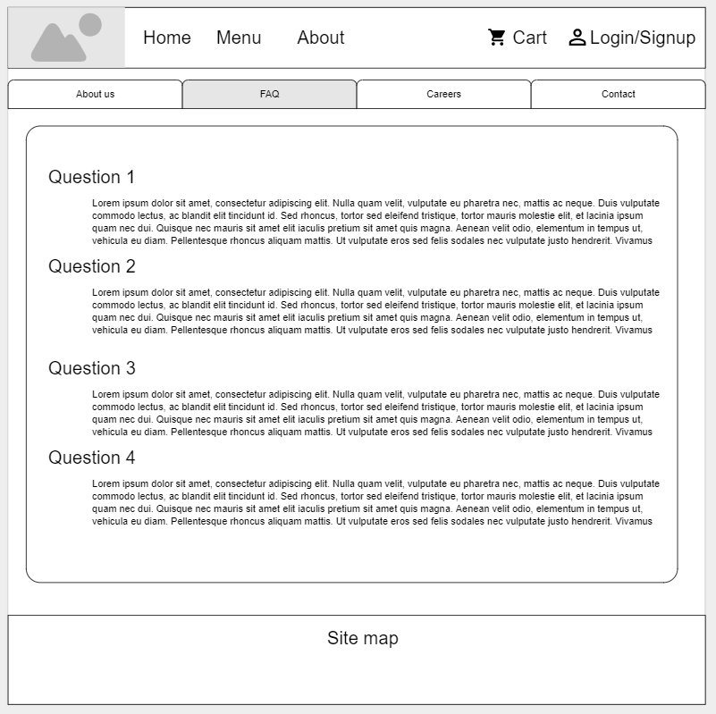
Upon clicking “FAQ” tab on “about”, it leads the user to the “FAQ” page
About: About us
About: FAQ

Slide 5
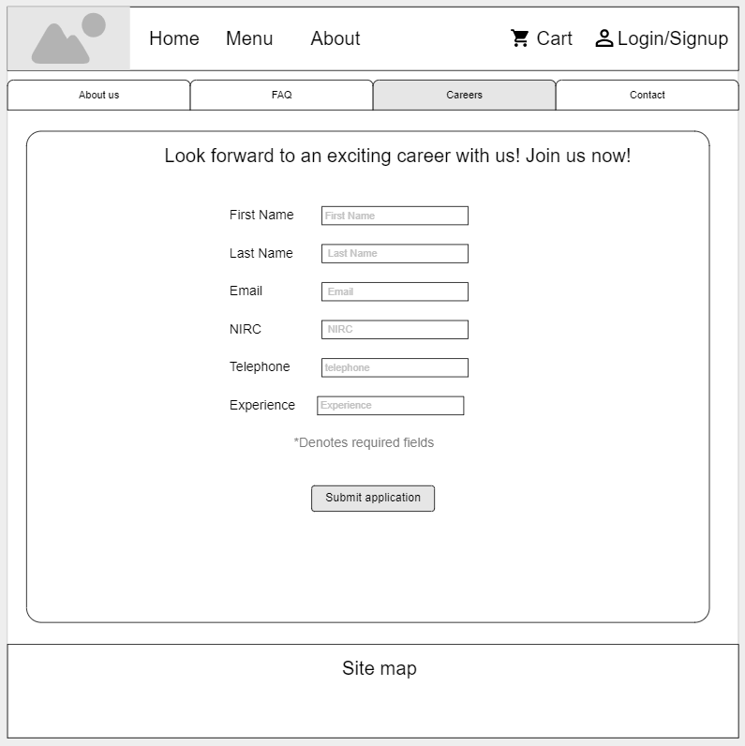
Upon clicking “Careers” tab on “about”, it leads the user to the “careers” page
About: About us
About: Careers

Slide 6
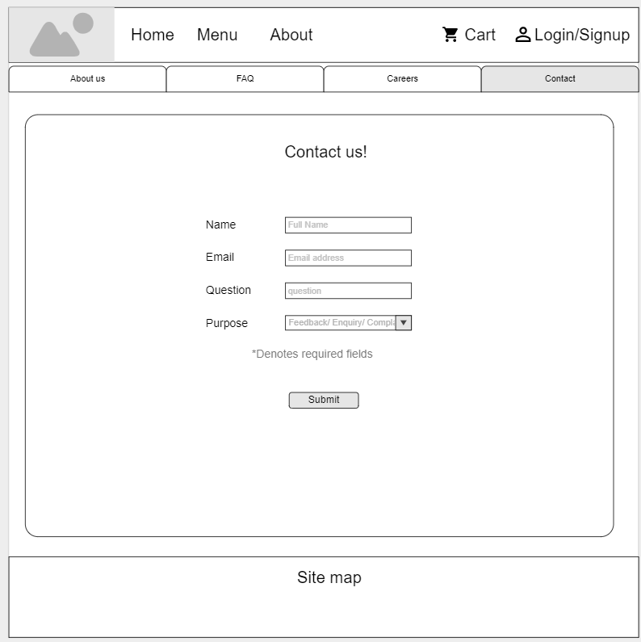
Upon clicking “Contact” tab on “about”, it leads the user to the “contact” page
About: About us
About: Contact

Slide 7
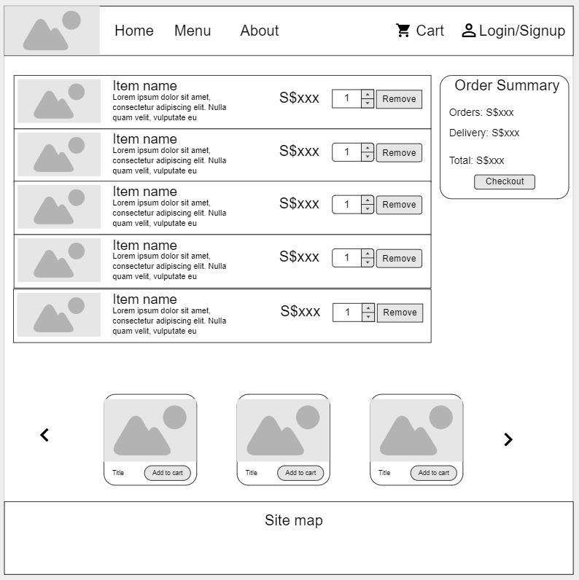
Item Description
Upon clicking add to cart from “item description” or “menu”, it leads the user to the “cart” page. Items gets added into this page.
Cart
Menu

Slide 8
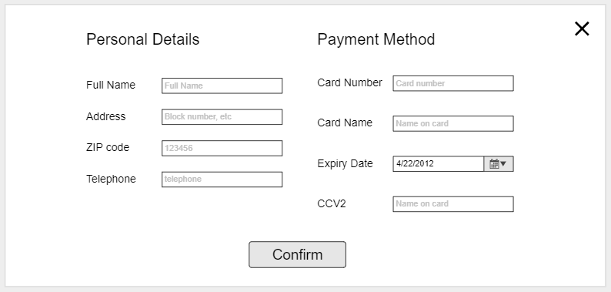
Upon checking out, the site will prompt the user to confirm to collect details and send an email to the user.
Cart
Confirmation pop-up

Slide 9
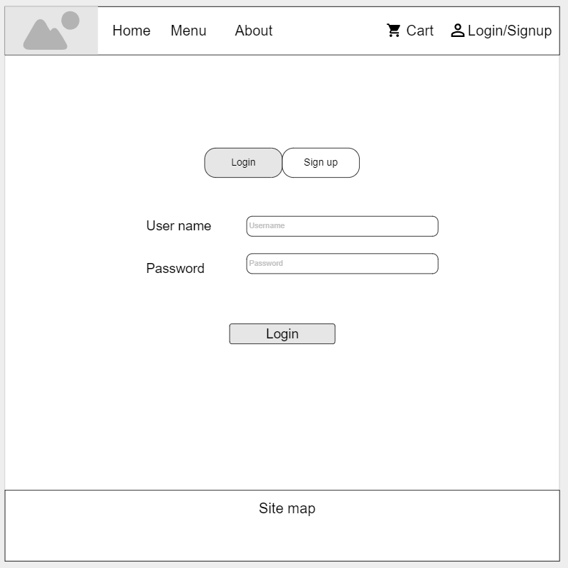
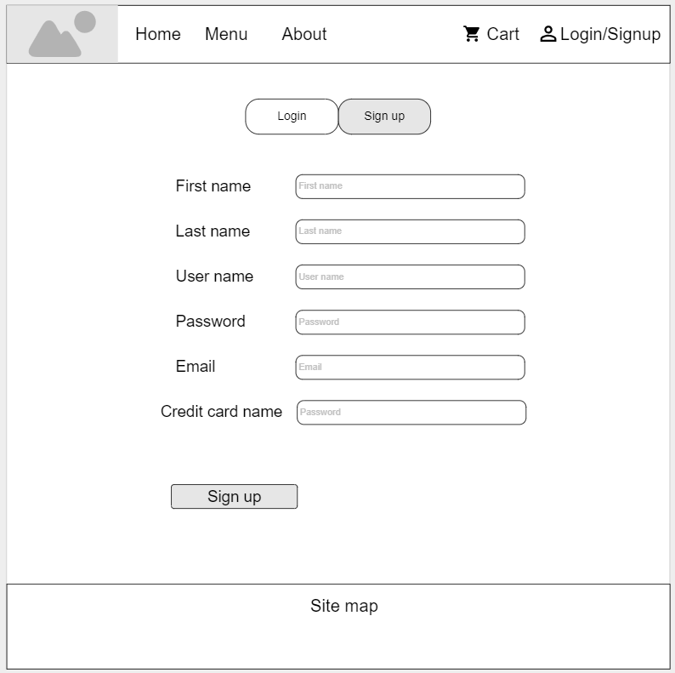
The login page and sign up page can be accessed from the top navigation bar
Login
Sign up

Slide 10
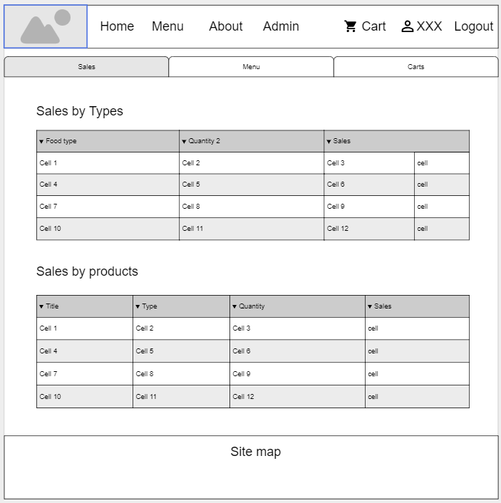
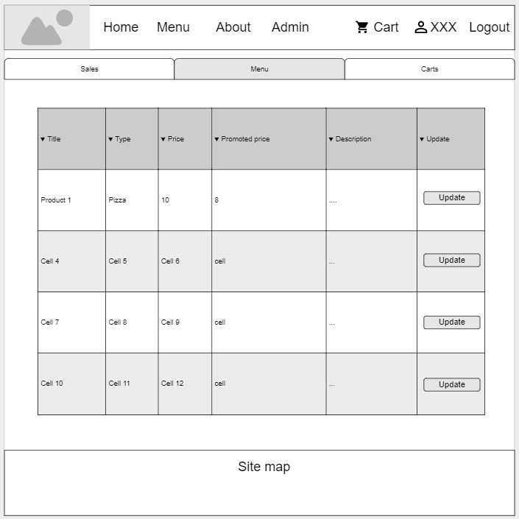
To access the admin page, the user has to have admin rights and login to his/her account. Here the admin may check the sales, menu and cart to check the sales, make changes to the menu items and see the cart order items made by each user respectively.
Admin
Menu

Slide 11
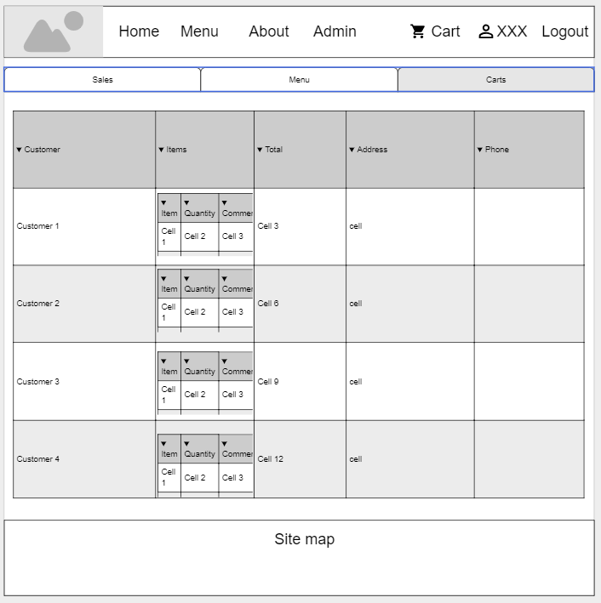
To access the admin page, the user has to have admin rights and login to his/her account. Here the admin may check the sales, menu and cart to check the sales, make changes to the menu items and see the cart order items made by each user respectively.
Cart

